Slide 1


GAME HACKING
GROUP 1
ANDREEA PETCU, CALVIN MENEZES, DEE DIXON, GRAEME BRODIE, KYLE MACQUEEN

Slide 2

Contents
Overview
Proxy and packet injection
Binary exploitation
Mapping and location

Slide 3





Overview
A proxy that intercepts packets with options to change them before being relayed back to the server
A map that can pull in intercepted position packets to show players distance from location
LD_PRELOAD=<my code$>$.so ./<target binary$>$
Notes:
Initial Research
Further review of Binary exploitation after lab
Observed LiveOverflow for help
Decided to focus on Networking
Proxy Research Starts
Overview
A proxy that intercepts packets with options to change them before being relayed back to the server
A map that can pull in intercepted position packets to show players distance from location

Slide 4
Play Game Begin the adventure!

Slide 5


Challenge 1: 400 points Decode the protocol !
In-game packets captured using Wireshark
Looked for meaningful ASCII text in the capture
Repeatedly performed actions with minor variations
Captured a wide variety of packets, makes decoding easier

Slide 6
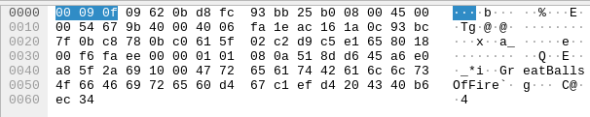



Challenge 1: 400 points Decode the protocol !
*i – Attack packet prefix, followed by weapon used (Fireball)
Notes:
Example of a packet we captured

Slide 7
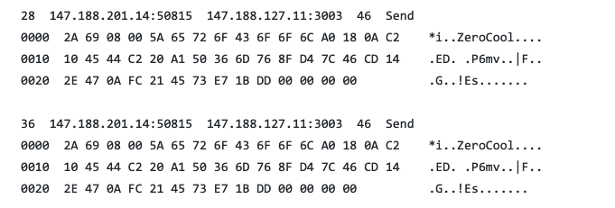










Challenge 1: 400 points Decode the protocol !
*i – Attack packet prefix, followed by weapon used (Snowball)
mv – Position packet prefix followed by (x,y,z) – 12 bytes
Notes:
Minor variation – the weapon

Slide 8
Challenge 1: 400 points Decode the protocol !
Raw data (hex dump) when a player enters the game
6e63a31f0000060072756e72756e0400677270320395d4db005151510010191f0000000000a07f17c70bae9ac6f05d1d45000086ba00001000477265617442616c6c734f6646697265640000000000
Notes:
Player enters the game, and this is what we captured

Slide 9
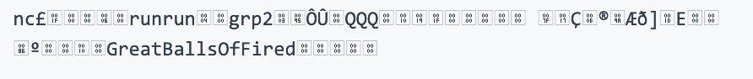


Challenge 1: 400 points Decode the protocol !
Fields identified
prefix [id ] [ln] [name ] [ln] [groupname] [position data] [ln] [equipped weapon name] [ ] number of status
6e63 a31f0000 0600 72756e72756e 0400 67727032 03 95d4db 00 515151 00 10191f 00 000000 00 a07f17c70bae9ac6f05d1d45 000086ba0000 1000 477265617442616c6c734f6646697265 64000000 0000
Notes:
We can detect these packets even if we’re not directly in line of sight of the player

Slide 10
Challenge 1: 400 points Decode the protocol !
cp (Item receive)
ee (talking to shop)
rm (pwncoin transaction)
jp (jump)
ma (mana update)
++ (health update)
pu (achievement)
ps (monster presence)
mk (object creation)
pp (other players presence)
st (status of player/monster)
ft (fast travel)
xx (player/monster death)
la (ammo)

Slide 11
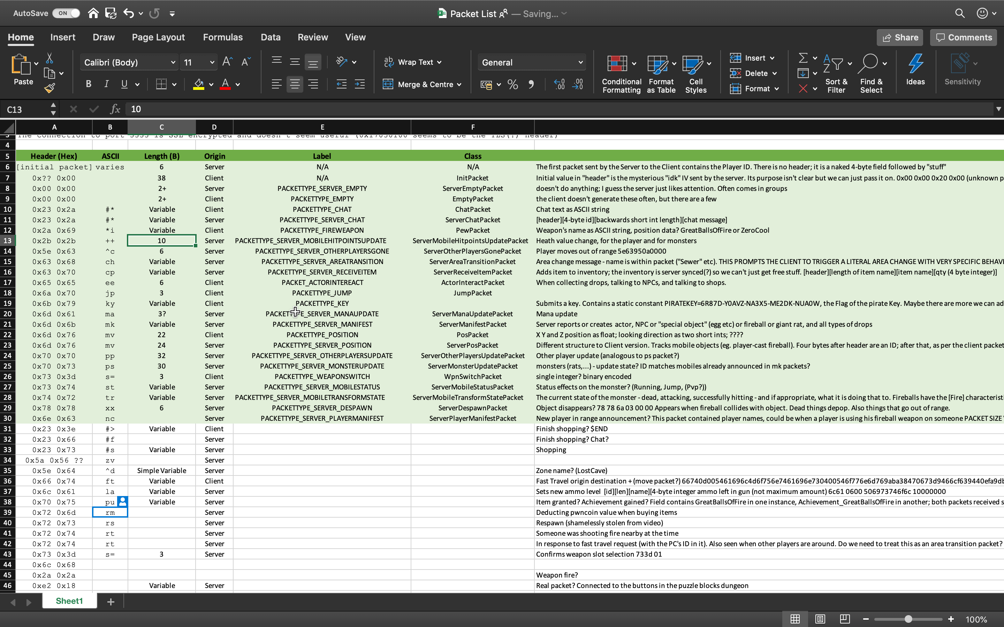

Slide 12

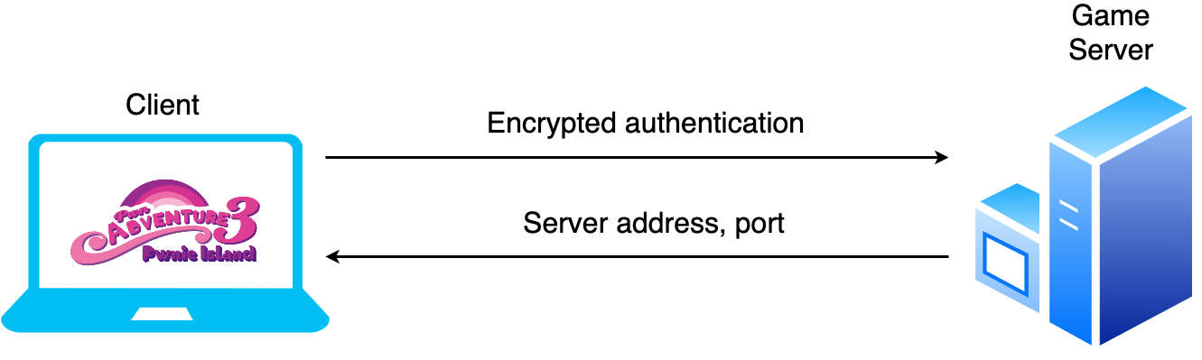
Challenge 2: 400 points MITM & Inject packets !
Notes:
Initial Connection – authorization with server
Game World Connection – initiated after successful authorization
Proxy (MITM) – intercepts and relays all game world connection data
Intercepted Traffic – Captured by our proxy 😈
Initial connection: Authorisation with server - We examined this traffic using Wireshark. - The traffic is encrypted. - MITM attack cannot decrypt this data, so we do not intercept it.Game world connection: Contains actual game world data - Server and port given by the server in encrypted authorisation channel. - Client connects to the specified server on the specified port. - The traffic is not encrypted! - This is our avenue of attackOur proxy intercepts and relays all game world connection data - We override a funcion in the client with LD_PRELOAD. - This overwrites the server URL with one of our own (typically localhost). - Proxy listens on all 10 possible game world ports. - We establish a proxy connection between the client and server.Intercepted traffic is - Packetised into Python objects. - Analysed according to a set of rules that make up our exploits. - Potentially dropped, modified or injected. - Sent on to the intended machine transparently.

Slide 13
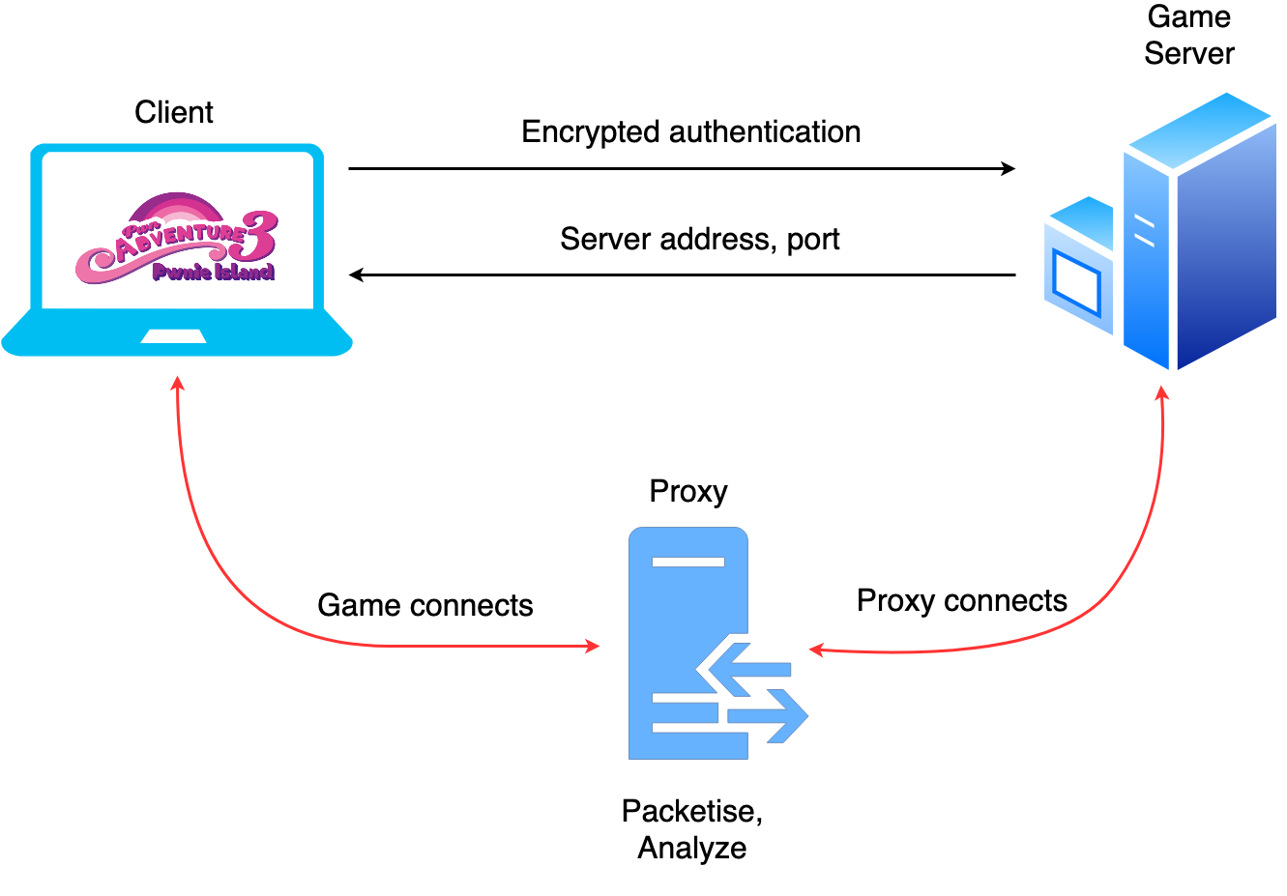
Notes:
Initial Connection – authorization with server
Game World Connection – initiated after successful authorization
Proxy (MITM) – intercepts and relays all game world connection data
Intercepted Traffic – Captured by our proxy 😈
Initial connection: Authorisation with server - We examined this traffic using Wireshark. - The traffic is encrypted. - MITM attack cannot decrypt this data, so we do not intercept it.Game world connection: Contains actual game world data - Server and port given by the server in encrypted authorisation channel. - Client connects to the specified server on the specified port. - The traffic is not encrypted! - This is our avenue of attackOur proxy intercepts and relays all game world connection data - We override a funcion in the client with LD_PRELOAD. - This overwrites the server URL with one of our own (typically localhost). - Proxy listens on all 10 possible game world ports. - We establish a proxy connection between the client and server.Intercepted traffic is - Packetised into Python objects. - Analysed according to a set of rules that make up our exploits. - Potentially dropped, modified or injected. - Sent on to the intended machine transparently.

Slide 14




Demo time!

Slide 15

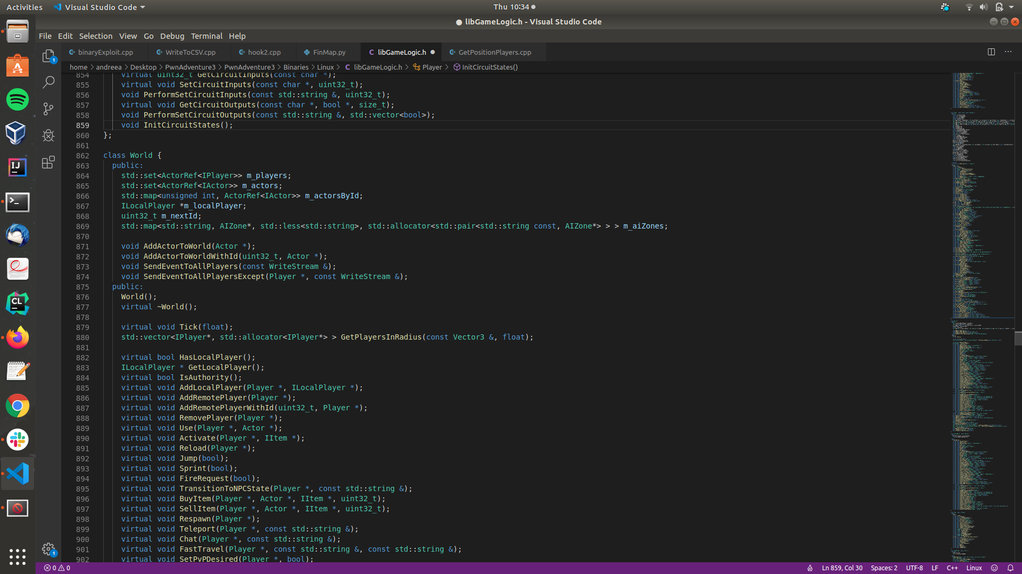

Challenge 3: 400 points Find other players !
LD_PRELOAD=GetPositionPlayers.so ./PwnAdventure3-Linux-Shipping

Slide 16
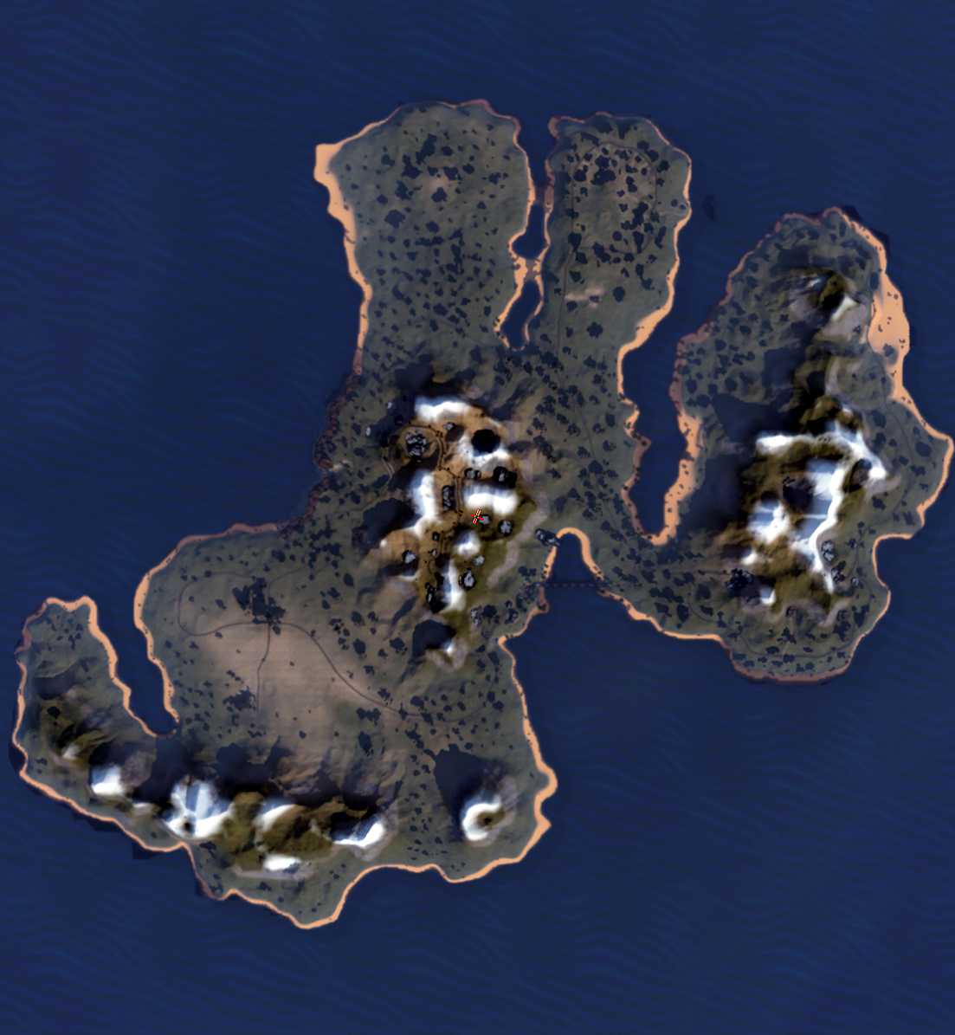



Challenge 4: 400 points Explore the island !
Click Position
Takes in several csv files to determine separate locations
ID, X, Y, Z – X Y are the only variables used but the other two allow for future upgrades
Notes:
Position vectors read out to CSV file
Pulled in by python script
Use of matplotlib
Several niche implementations stacked

Slide 17
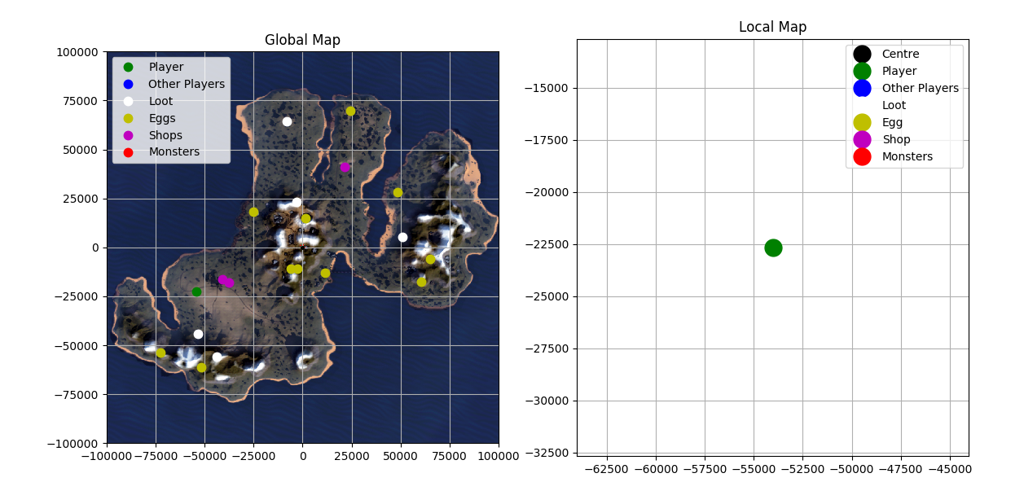
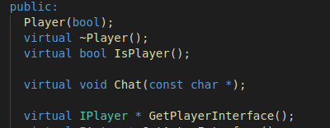
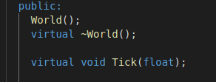
Final challenge: 400 points Click and travel !
LD_PRELOAD=teleport.so ./PwnAdventure3-Linux-Shipping
Notes:
Initial Research
Further review of Binary exploitation after lab
Observed LiveOverflow for help
Decided to focus on Networking
Proxy Research Starts
Overview
A proxy that intercepts packets with options to change them before being relayed back to the server
A map that can pull in intercepted position packets to show players distance from location

Slide 18
Demo time!

Slide 19




ALL CHALLENGES UNLOCKED!

Slide 20
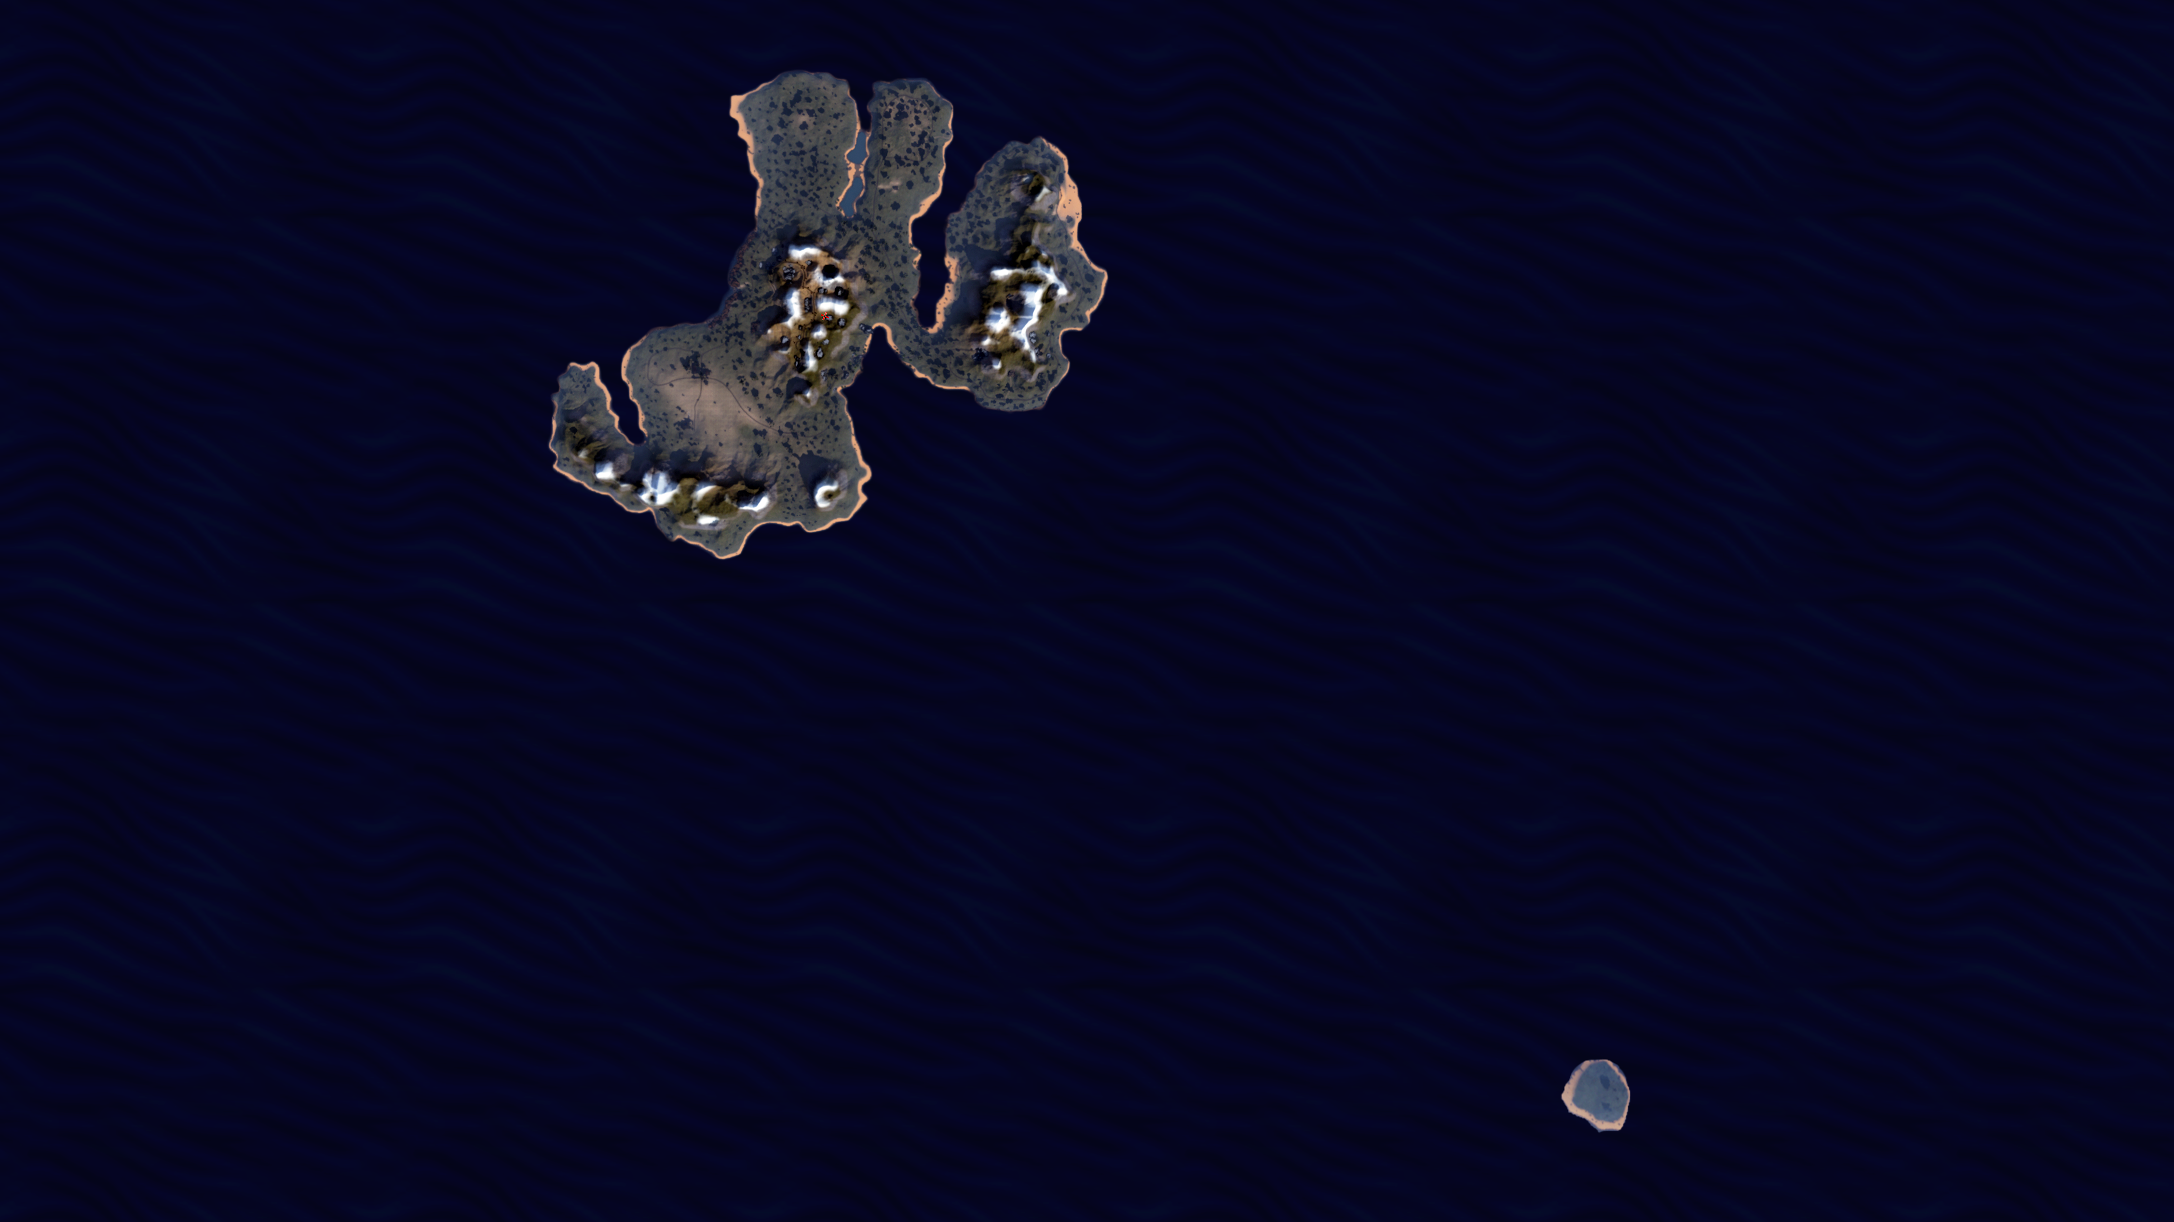
Big thanks from the tiny island

